Slide 1
Working with SharePoint Content
Using mocks to simulate SharePoint data

Slide 2
Agenda
What is mock data?
Why use mock data?
How to use mock data
Q&A

Slide 3


Mock data simulates dynamic data returned from SharePoint or another data source.

Slide 4
Why use mock data?
Local Workbench has no SharePoint context
Use mock data to simulate SharePoint context
Allows you to build the web part locally without even running in SharePoint
You can implement the UI behaviors even without accessing the SharePoint code
It’s good practice to have mocked data for local workbench hosting

Slide 5
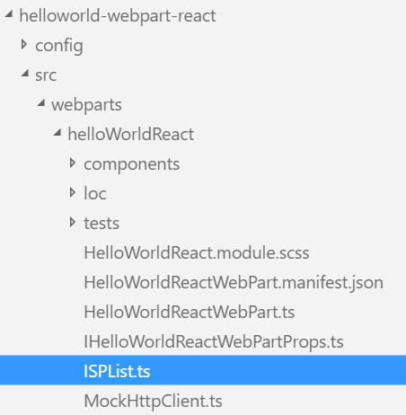
How to use mock data?
Create a data model for the mock data
export interface ISPList {
Title: string;
Id: string;
}

Slide 6
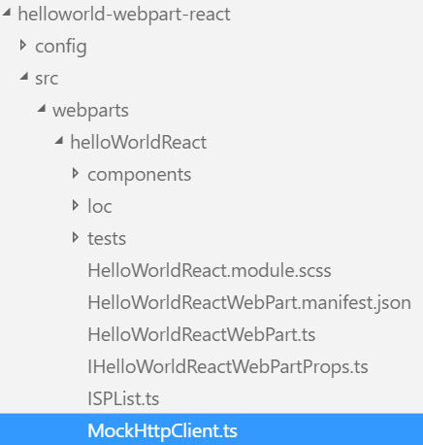
How to use mock data?
Create a MockHttpClient class
Import the data model into the MockHttpClient class
Create an instance of the data model
Populate the instance of the data model with mock data
Create a method to return the mock data
import { ISPList } from './ISPList';
export default class MockHttpClient {
private static _items: ISPList[] = [
{ Title: 'Mock List 1', Id: '1' },
{ Title: 'Mock List 2', Id: '2' },
];
public static get(restUrl: string, options?: any): Promise<ISPList[]> {
return new Promise<ISPList[]>((resolve) => {
resolve(MockHttpClient._items);
});
}
}

Slide 7
How to use mock data?
Import the MockHttpClient class and data model into the web part class
Create a method to invoke the method in the MockHttpClient and return the mock data
Check the EnvironmentType to determine if the web part is running in the local environment
Invoke the method to return the mock data
import MockHttpClient from './MockHttpClient';
import { ISPList } from './ISPList';
private _getMockListData(): Promise<ISPList[]> {
return MockHttpClient.get(this.context.pageContext.web.absoluteUrl)
.then((data: ISPList[]) => {
return data;
});
}
if (this.context.environment.type === EnvironmentType.Local) { this._getMockListData() }

Slide 8
DEMO
Using mocks to simulate SharePoint data
Notes:
Use Exercise 1: Using mocks to simulate SharePoint data in the lab manual.

Slide 9
Summary
What is mock data?
Why use mock data?
How to use mock data
Q&A

Slide 10
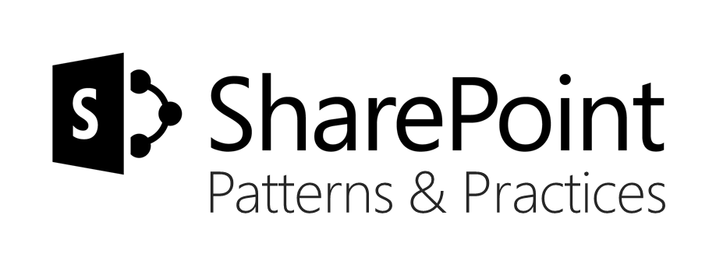
Sharing is caring…
Code samples and solutions
Reusable components
Guidance documentation
Monthly community calls
SharePoint Framework
SharePoint add-ins
Microsoft Graph
Office 365 APIs
http://aka.ms/SharePointPnP

Slide 11

Q&A

Slide 12


